Slide 1

Data Science Bootcamp
Dataset exploration :
Speed Dating
Nicolas BRIDELANCE
Linked In
GitHub

Slide 2

Sommaire
Présentation du dataset
Quelques pistes d’exploration
Un peu de Machine Learning
Limites de l’exercice

Slide 3
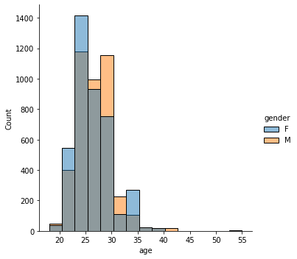
Age distribution within dataset
Age distribution :
Men older than Women

Slide 4
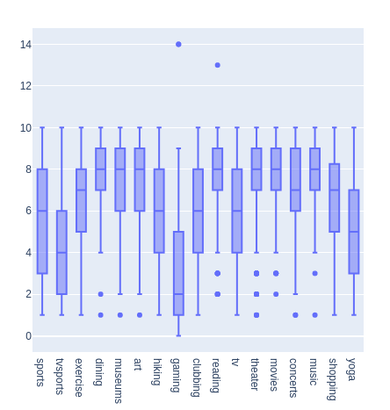
Activities - women
What they DON’T like :
gaming
tvsports / sports
yoga
hiking
clubbing
…tv ?

Slide 5
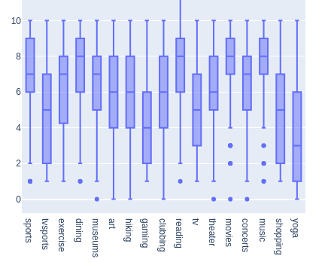
Activities - men
What they DON’T like :
gaming
tvsports BUT they like sports
yoga
shopping
…tv ?

Slide 6
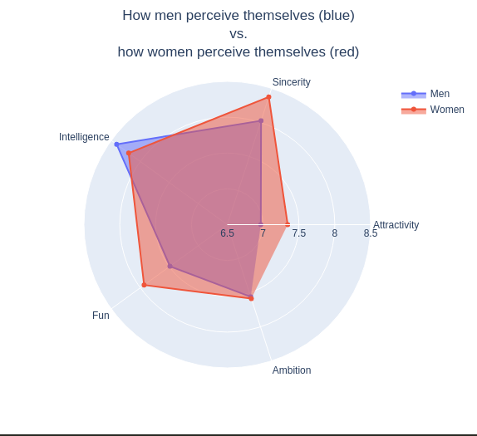
Difference of self perception in genders
On average :
Men perceive themselves as more intelligent
Women perceive themselves as more fun
Women perceive themselves as more attractive
Women perceive themselves as more sincere

Slide 7
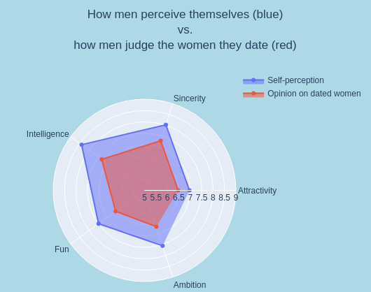
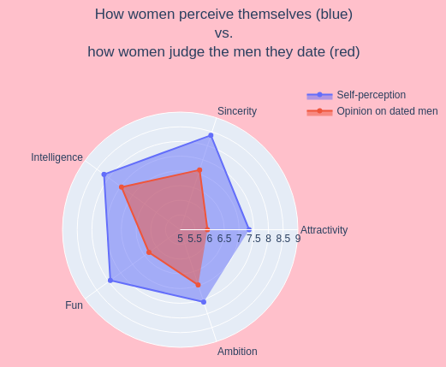
Self perception vs judgement
Both sexes judge more harshly others than they judge themselves

Slide 8
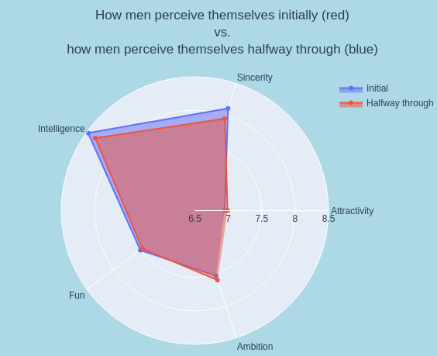
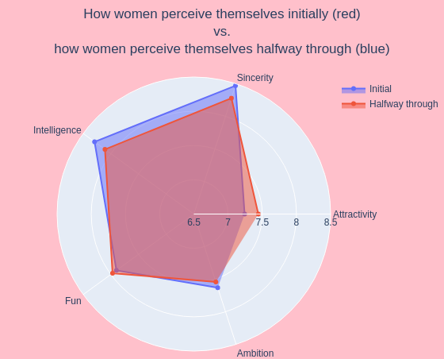
Evolution of self perception during speed dating event
On average :
After a few dates, both sexes tend to feel :
  LESS intelligent than initially
  LESS sincere than initially
Women tend to feel noticeably MORE attractive after a few dates

Slide 9
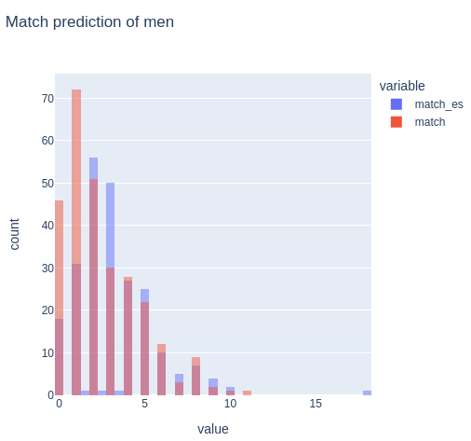
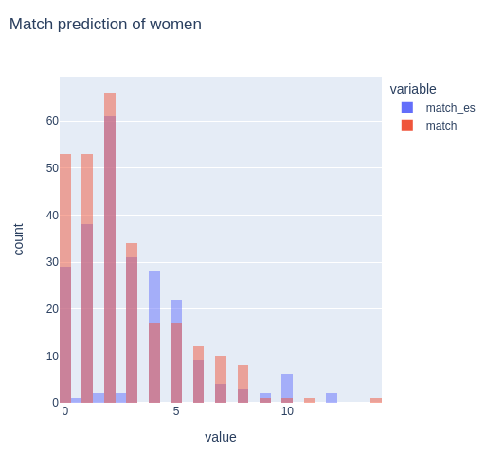
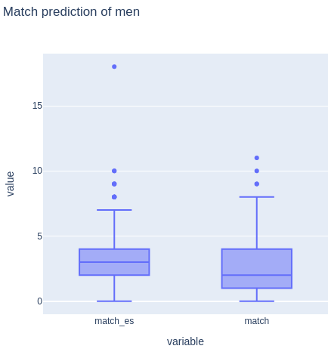
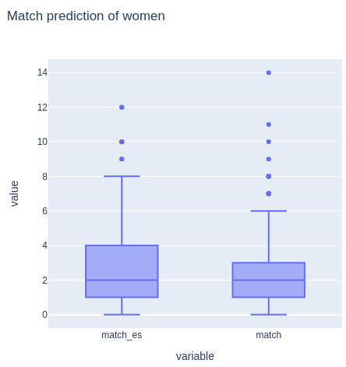
Prevision of matches by gender
On average, less received than expected, median man thinks will have more match than effectively seen

Slide 10
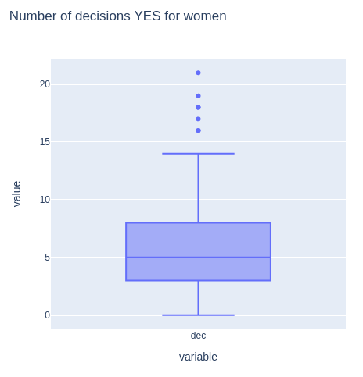
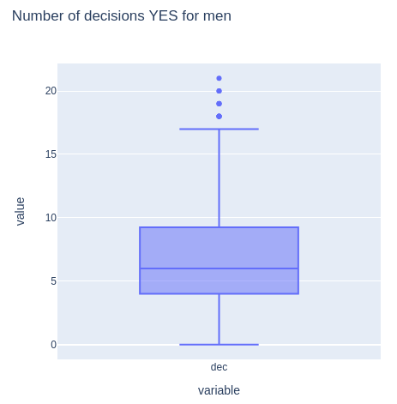
Decisions to say YES
Men say YES more often

Slide 11
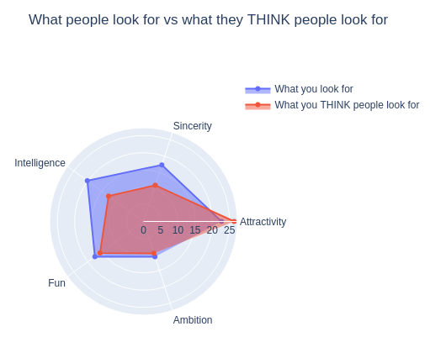
How different do people THINK they are?
People feel pretty different from average
People feel that other people would rank:
attractiveness higher than themselves
sincerity and intelligence lower than themselves

Slide 12
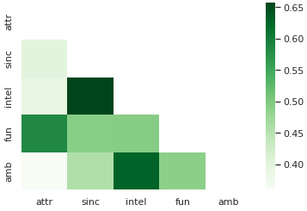
How do you judge ?
High correlation between Fun and Attractiveness
High correlation between Intelligence and Ambition
High correlation between Intelligence and Sincerity

Slide 13
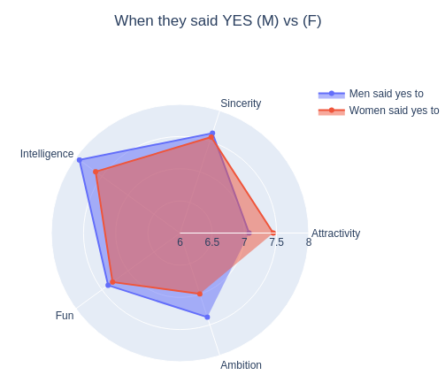
When do they say YES ?
Women tend to say yes to
higher intelligence and ambition
Men tend to say yes to
higher attractiveness

Slide 14
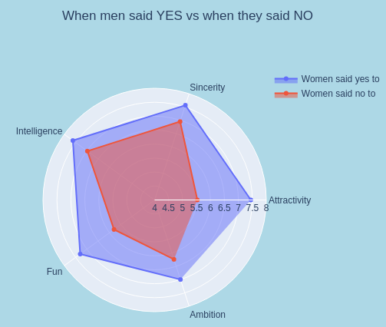
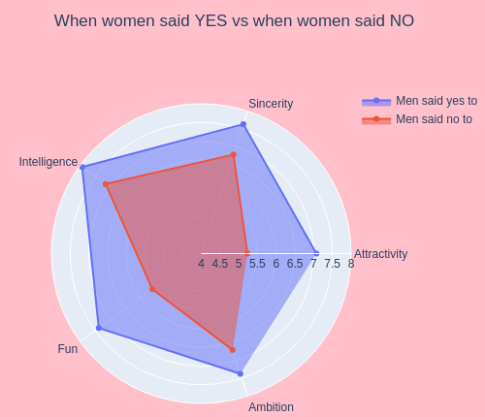
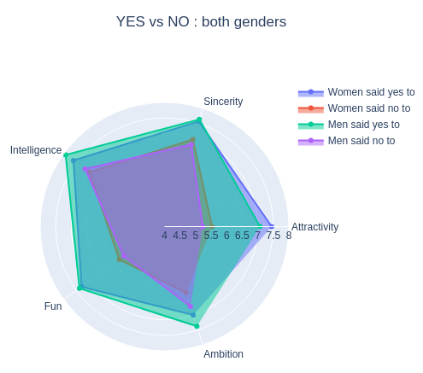
YES vs NO
Big gap between acceptation and rejection
Small difference between genders

Slide 15

Thank you!
Any questions?

